Slide 1

Case study: Active Learning via Bayesian Optimization for Discovery of Energy Storage Materials
AI Science Tutorial 2021
Hieu A. Doan
Garvit Agarwal
Molecular Materials Group
Materials Science Division

Slide 2
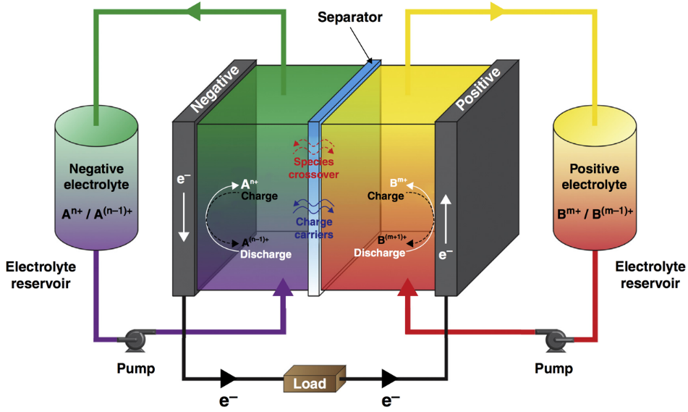
Redox Flow Battery (RFB) as a Stationary Energy Storage System
Advantages:
Separation of energy and power capacity
Integration of intermittent renewable energy sources into the electrical grid
Non-aqueous RFBs potentially yield high energy density and lower cost
Kowalski, Su, Milshtein, Brushett (2016) Current Opinion in Chemical Engineering

Slide 3
Electrode Passivation by Damaged Redoxmers
E.g.:
=
Normal redox cycling
Electrode

Slide 4
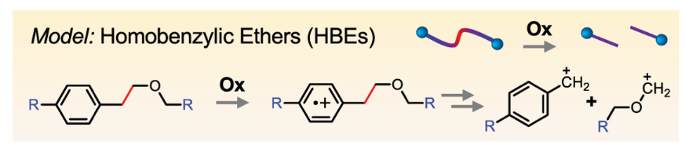
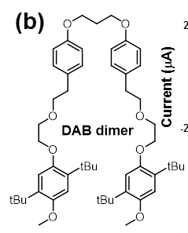
Designing Backbone with Cleavable Tethers
E.g.:
=
Normal redox cycling
Programmed
redox trigger
Electrode
=
Qian, Counihan, Doan, Danis, Setwipatanachai, Purwanto, Rodríguez-López, Assary, Moore. 2020. Under review.
Programmable redox triggered fragmentation removes deposits from electrodes and regenerate active redoxmers

Slide 5
Designing Backbone with Cleavable Tethers
E.g.:
=
Desirable HBEs’ properties:
Suitable redox potential windows
Favorable mesolytic cleavage pathways
High solubility
Ease of synthesis
Electrochemical reversibility
Desirable HBEs’ properties:
Suitable redox potential windows
Favorable mesolytic cleavage pathways
High solubility
Ease of synthesis
Electrochemical reversibility
Normal redox cycling
Programmed
redox trigger
Electrode
=
Qian, Counihan, Doan, Danis, Setwipatanachai, Purwanto, Rodríguez-López, Assary, Moore. 2020. Under review.
Programmable redox triggered fragmentation removes deposits from electrodes and regenerate active redoxmers

Slide 6
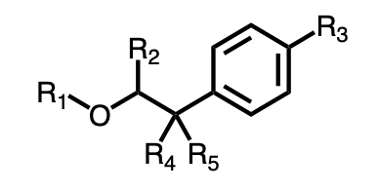

The Challenges
1. Large space of molecular candidates
HBE scaffold
SMILES (Simplified Molecular-Input Line Entry System)
$$\sim$$
﻿[R3]C1=CC=C(C([R4])([R5])C([R2])-[O][R1])C=C1
R₁ = -Me, -Et, -Pr, -Ph, -CN, -Eth, -COMe,
R₂ = -H, -Me, -Ph, -OMe, -Br, -CN
R₃ = -H, Et, -OMe, -N(Me)₂, -CN, -NO₂, -COOMe, -Ph
R₄ , R₅ = -H, -Me, -Ph, CN
> 1000 HBEs
2. Expensive/time-consuming synthesis and characterization

Slide 7
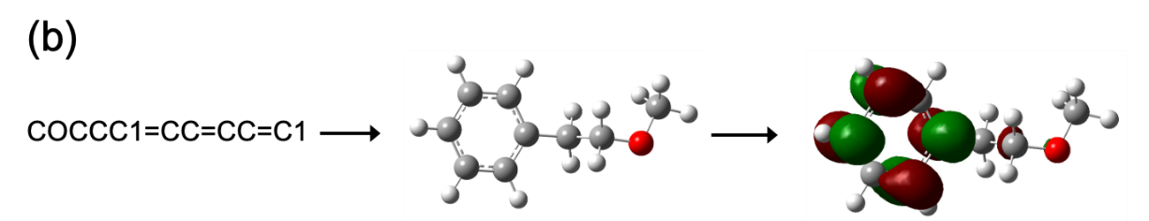
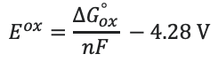
The Opportunities
1. Density Functional Theory (DFT) calculations starting from SMILES
SMILES
3D coordinates
Geometry optimization
E^{ox} calculation
$$E^{ox}=\frac{∆G_{ox}^{°}}{nF} −4.28 V$$
2. Good agreement between DFT-computed and experimentally measured values
MAE = 0.11 V
1
2
3
4
5
6
7
8
9
10
11
Use DFT calculations to quickly and reliably measure E^{ox} for HBE molecules
7

Slide 8
Problem definition for Machine Learning model
Input
Output/Objective
Molecule candidates
(SMILES library)
Molecules w/ desired oxidation potential
“SMILES.csv”
RDKit
Feature vectors
E.g.
MW | # of C | # of aromatic rings | …
179 | 11 | 1 | …
“features.csv”

Slide 9
Bayesian optimization scheme
Objective: Given 1000 HBE molecules, find one with maximized E^{ox} within N evaluations
“features.csv”
“computedEox.csv”
“SMILES.csv”
HBE Library
Features
Initial training data
E^{ox} Evaluation
SMILES strings
MW, logP, TPSA…
Principle Component Analysis
10 random HBEs
DFT calculations
Next HBE
Computed E^{ox}
to test
Bayesian optimization
boCycles()
Test data
Remaining HBEs
Iteration
Remaining set
Training set
0 990 10
1 989 11
Acquisition Function
Predicted
Surrogate Model
Expected-improvement
μ, Σ
Gaussian Process Regression
2 988 12
…
…
…
expectedImprovement()
gprediction()
gpregression()
N 990-N 10+N

